Slide 1
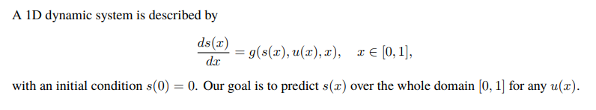


A simple ODE case
s
Then, the operator G would be:

Slide 2
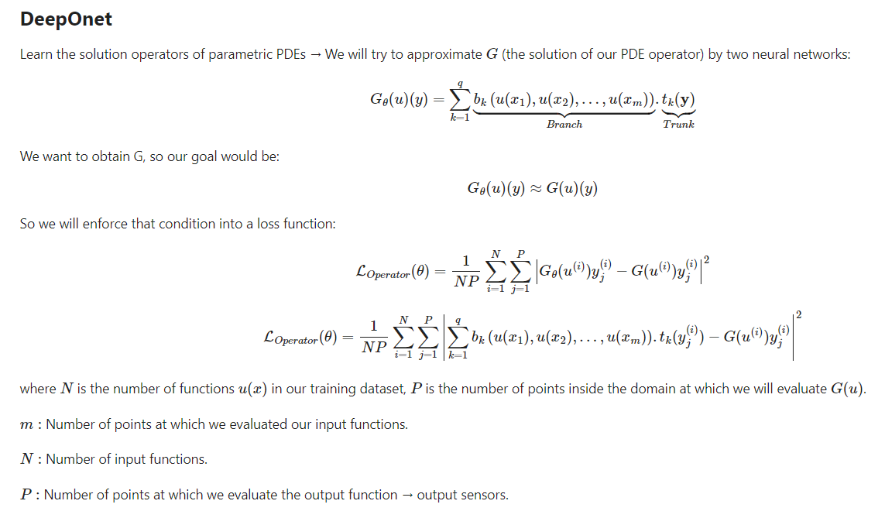

Slide 3


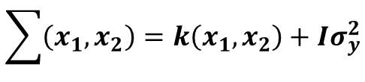
How to generate data?
We can choose uniformly m + 1 points $x_{j} = a + j(b − a)/m,$ j = 0, 1, · · · , m from [a, b], and define the function $u_{m}(x)$ as follows:
Regression using Gaussian:
$$\sum{\left(x_{1},x_{2}\right)}=k\left(x_{1},x_{2}\right)+Iσ_{y}^{2}$$
$$k\left(x_{1},x_{2}\right)=σ^{2}ⅇ^{\frac{1}{2l^{2}}\left(x_{1}−x_{2}\right)}$$

Slide 4


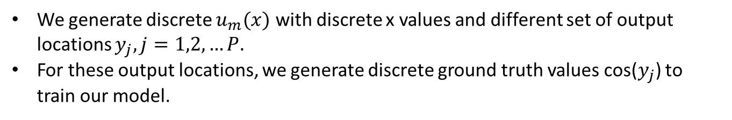


We generate discrete $u_{m}(x)$ with discrete x values and different set of output locations $y_{j}, j=1,2,…P.$
For these output locations, we generate discrete ground truth values cos($y_{j}$) to train our model.
$$u\left(x\right)$$
DeepONet
G(u)(y)
$$y_{k}$$
P: Total no. of output locations
q: no. of branch nets or no. of neurons in output layer of trunk net
Predictions Ground truth
Then we can define the loss function as follows:
$$L(θ)$$
s

